Slide 1
Reinforcement Learning Tutorial
Reza Marzban

Slide 2
Main concept
Sub-area of ML.
All about taking suitable action to maximize reward based on data from environment.
The input is the initial state of the agent
Output is the reward or the punishment of agent based on its action.

Slide 3

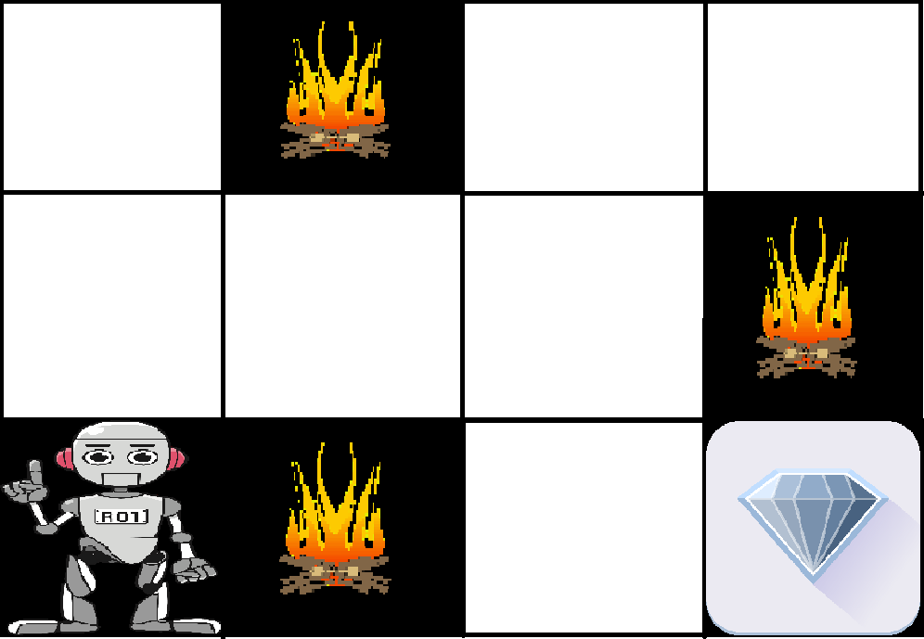
Main concept

Slide 4

Main Concept

Slide 5
Key terms
Environment: Physical world in which the agent operates
State: Current situation of the agent
Reward: Feedback from the environment
Policy: Method to map agent’s state to actions
Value: Future reward that an agent would receive by taking an action in a particular state

Slide 6
Reinforcement vs Supervised learning
REINFORCEMENT LEARNING | SUPERVISED LEARNING
Reinforcement learning is all about making decisions sequentially. In simple words we can say that the out depends on the state of the current input and the next input depends on the output of the previous input | In Supervised learning the decision is made on the initial input or the input given at the start
In Reinforcement learning decision is dependent, So we give labels to sequences of dependent decisions | Supervised learning the decisions are independent of each other so labels are given to each decision.
Example: Chess game | Example: Object recognition

Slide 7
RL Practical applications
RL can be used in robotics for industrial automation.
RL can be used in machine learning and data processing
RL can be used to create training systems that provide custom instruction and materials according to the requirement of students. (Human–robot interaction)

